Slide 1

Introduction to Environmental Engineering Chapter I Part II

Slide 2
UNITS OF MEASUREMENTS
The ability to solve problems by engineering calculations holds the essence of engineering.
Engineering calculations makes easy description of the physical world in terms of units and dimensions that is understandable by all.
Units: Units simply describe what the quantity is about.
The measurement and reporting of any environmental quantity is done by the description of its values and units. For example: snow mass of 500 km³, river discharge of 500 m³/s, a sand particles of 2 mm.

Slide 3
Values, Units and Dimensions
The study of environmental engineering requires assessment of both extremely large and extremely small quantities.
Thus it is essential to use a practical and less scientific figure to represent quantity under consideration.
Dimension : Dimension is a descriptive unique quantity that describes a basic characteristic of the measurement. Example: Mass (M), Length (L) and Time (T).
Dimensions are descriptive but not numerical. They can not describe how much; they simply describe what. For example, the length (L) dimension may be described in units as meters, inches or Angstrom.

Slide 4
Common Prefixes
Quantity | Prefix | Symbol
10 ⁻¹² | pico | p
10⁻⁹ | nano | n
10⁻⁶ | micro | μ
10⁻³ | milli | m
10⁻² | centi | c
10⁻¹ | deci | d
10 | deca | da
10² | hecto | h
10³ | kilo | k
10⁶ | mega | M
10⁹ | giga | G

Slide 5
EX.2: Size and scale of measurement
Substances | Size
 | μm | mm | cm | m
Bacteria | 1
Sand |  | 1
Gravel |  |  | 1
39’ TV |  |  |  | 1

Slide 6
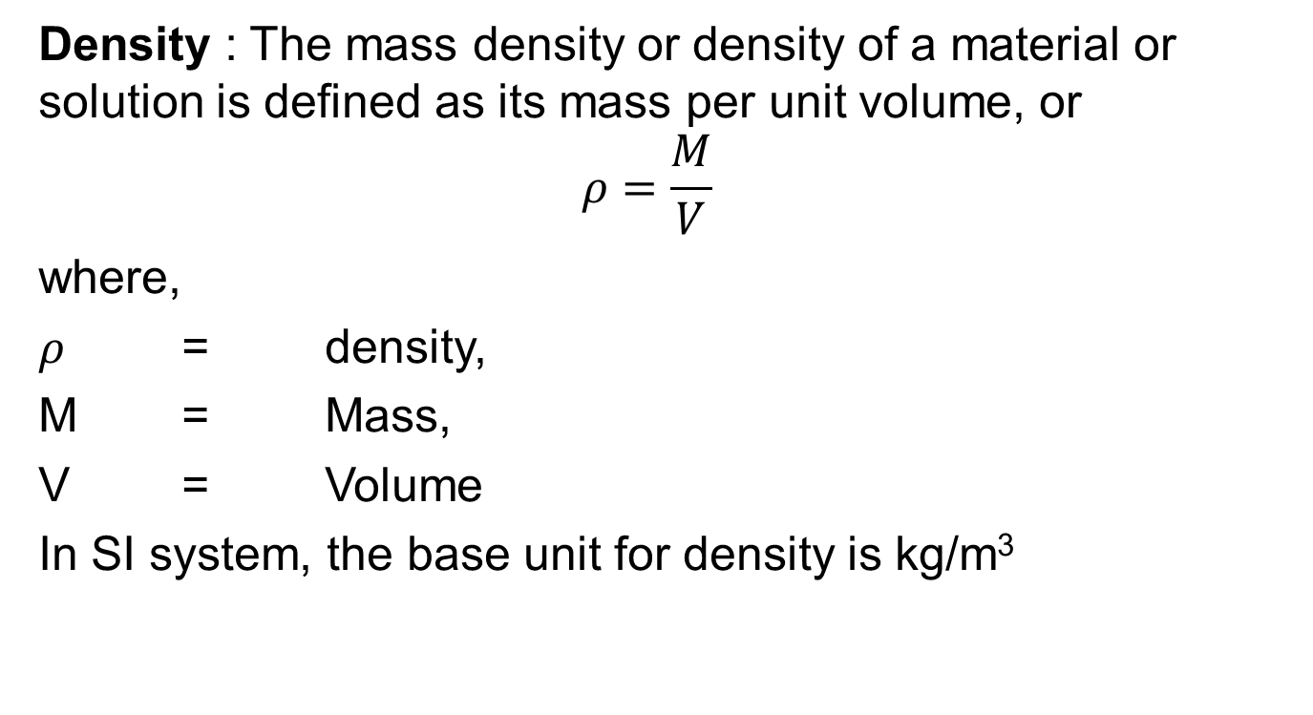
Concentration and Density
Density : The mass density or density of a material or solution is defined as its mass per unit volume, or
$$ρ=\frac{M}{V}$$
where,
$ρ$ = density,
M = Mass,
V = Volume
In SI system, the base unit for density is kg/m³

Slide 7
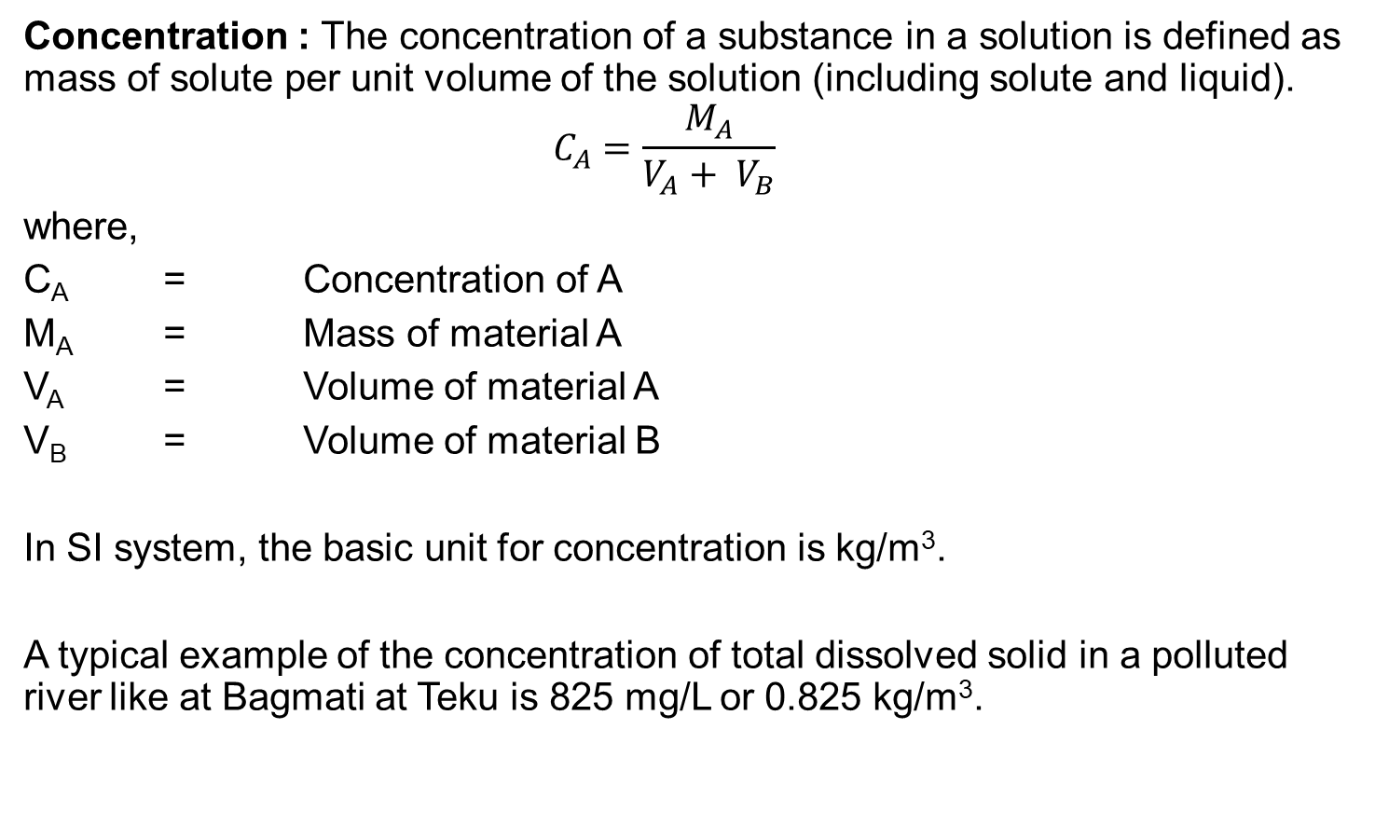
Concentration and Density
Concentration : The concentration of a substance in a solution is defined as mass of solute per unit volume of the solution (including solute and liquid).
$$C_{A}=\frac{M_{A}}{V_{A}+ V_{B}}$$
where,
C_{A} = Concentration of A
M_{A} = Mass of material A
V_{A} = Volume of material A
V_{B} = Volume of material B
In SI system, the basic unit for concentration is kg/m³.
A typical example of the concentration of total dissolved solid in a polluted river like at Bagmati at Teku is 825 mg/L or 0.825 kg/m³.

Slide 8
Since solutes in solution are often analyzed by weight, the terms milligram per liter or microgram per liter are used. It is often assumed that the substance does not change the density of water. If such assumption is made and we recall that 1 mL water weighs 1 g, then,

Slide 9
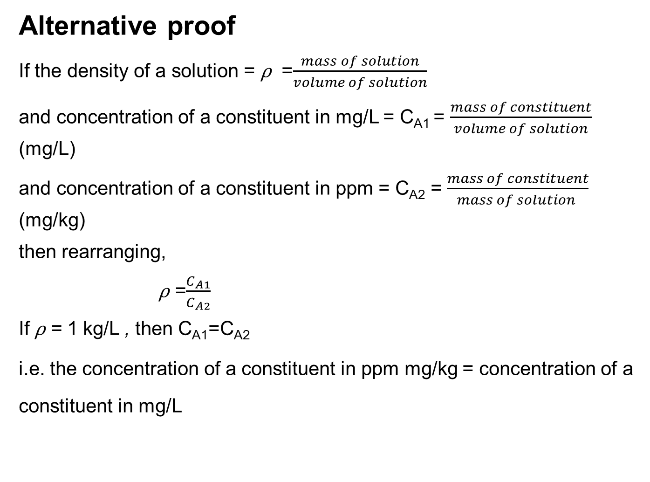
Alternative proof
If the density of a solution = ⍴ =$\frac{mass of solution}{volume of solution}$
and concentration of a constituent in mg/L = C_{A1} = $\frac{mass of constituent}{volume of solution}$ (mg/L)
and concentration of a constituent in ppm = C_{A2} = $\frac{mass of constituent}{mass of solution }$ (mg/kg)
then rearranging,
⍴ =$\frac{C_{A1}}{C_{A2}}$
If ⍴ = 1 kg/L , then C_{A1}=C_{A2}
i.e. the concentration of a constituent in ppm mg/kg = concentration of a constituent in mg/L

Slide 10
Concentrations in Air
Concentrations of chemicals in air are typically measured in units of the mass of chemical (milligrams, micrograms, nanograms, or picograms) per volume of air (cubic meter).
However, concentrations may also be expressed as parts per million (ppm) or parts per billion (ppb) by using a conversion factor.
The conversion factor is based on the molecular weight of the chemical and is different for each chemical.
Also, atmospheric temperature and pressure affect the calculation.

Slide 11
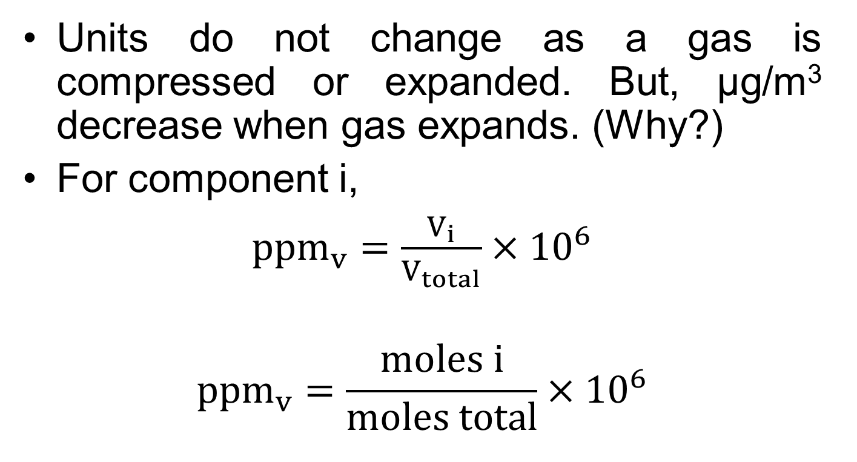
Concentrations in Air
Units do not change as a gas is compressed or expanded. But, μg/m³ decrease when gas expands. (Why?)
For component i,
${ppm}_{v}=\frac{V_{i}}{V_{total}}×{10}^{6}$
$${ppm}_{v}=\frac{moles i}{moles total}×{10}^{6}$$

Slide 12
Concentrations in Air
Typically, conversions for chemicals in air are made assuming a pressure of 1 atmosphere and a temperature of 273.15 K, where one mole of any pure gas will occupy a volume of 22.4 L.
Using ideal gas equation:
PV = nRT
R = 8.314 J/mole-K, 0.08205 L-atm/mole-K

Slide 13
Exercise 3
1 kg of soil sample was analyzed and found to contain 5.0 mg TCE. What is the TCE concentration in mg/kg, ppm and ppb?
Solution
5 ppm_{m} and 5000 ppb_{m}
In soil and sediments, mg/kg equals ppm_{m} and μg/kg equals ppb_{m}.

Slide 14
Flow (discharge) rate
The flow rate can be expressed as volume of the liquid per unit time,
Q_{V} = V/T, where,
Q_{V} = Volumetric flow rate,
V = Volume of the liquid,
T= Time period
In SI system, the basic unit of volumetric flow rate is m³/s.
Commonly used units for flow measurement are: liter per second (lps), liter per day (LD), millions liter per day (MLD), cubic meter per second (m³/s)
Note: 1 m³ = 1000 L
1 MLD = 10⁶ Liters per day

Slide 15
Flow (discharge) rate
In engineering processes the flow rate can be either volume flow rate or mass flow rate. Mass and volumetric flow rates are not independent quantities because the mass (M) of material passing a point in a flow line during unit time is related to the volume (V) of that material
Q_{M} = M / T = (Concentration × Volume) / T = Concentration × Volumetric flow rate
Q_{M} = C_{A}×Q_{V}

Slide 16
Mass flow rate
Mass flow rate of waste materials is also called as “waste load” or Mass Loading rate.
measured in kg/day.
Example,
The Biological Oxygen demand (BOD) of a wastewater dis measured in mg/L;
Therefore, this concentration should be multiplied by the wastewater flow rate to get the BOD load.
Q_{L} = BOD (kg/L) X Q (L/day)
Mass removal rate when we consider the efficiency of treatment plant.

Slide 17
Exercise 4
A stream can have a sediment load of up to 2000 mg/L in the rainy season. The stream water has been diverted using a dam and is supplied to a treatment plant. The tapped flow is 25 lps (liters per second). Find the mass flow rate of the sediment in the influent pipe. If the treatment plant can remove 90 % of the suspended solids, find the concentration of sediments in the effluent of treatment plant ?

Slide 18
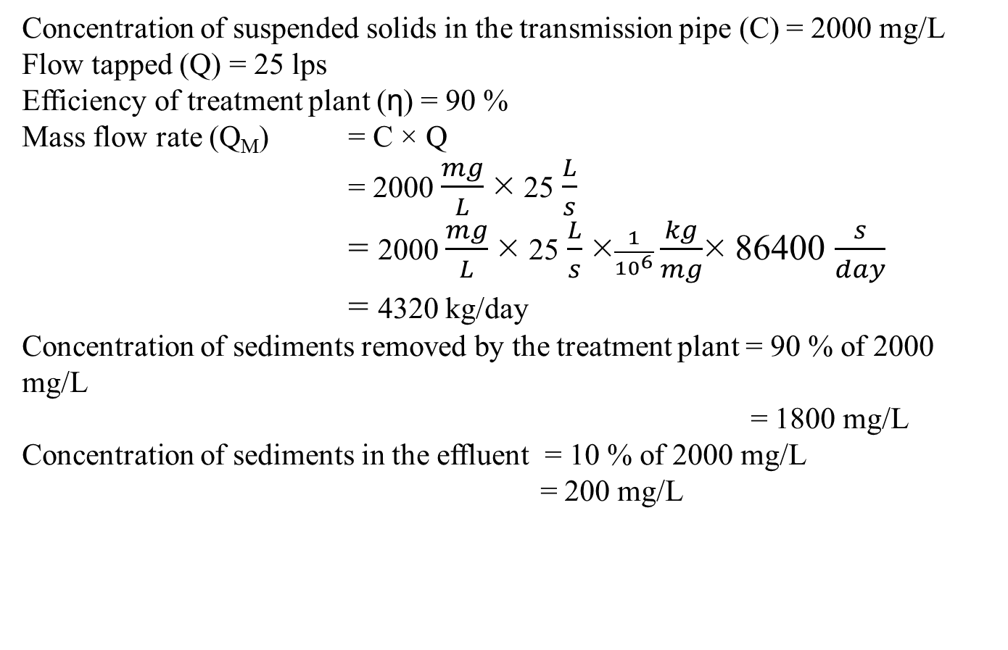
Concentration of suspended solids in the transmission pipe (C) = 2000 mg/L
Flow tapped (Q) = 25 lps
Efficiency of treatment plant (η) = 90 %
Mass flow rate (Q_{M}) = C × Q
= 2000 $\frac{mg}{L}$× 25$\frac{L}{s}$
= 2000 $\frac{mg}{L}$× 25$\frac{L}{s}$×$\frac{1}{{10}^{6}}\frac{kg}{mg}$× 86400 $\frac{s}{day}$
= 4320 kg/day
Concentration of sediments removed by the treatment plant = 90 % of 2000 mg/L
= 1800 mg/L
Concentration of sediments in the effluent = 10 % of 2000 mg/L
= 200 mg/L

Slide 19
Hydraulic Retention Time
One of the most important concepts in treatment processes
Retention time, also called detention time or even residence time
The time an average particle of the fluid spends in a container through which the fluid flows (which is the time it is exposed to treatment or a reaction).
In SI system, the basic unit of retention time is sec.

Slide 20
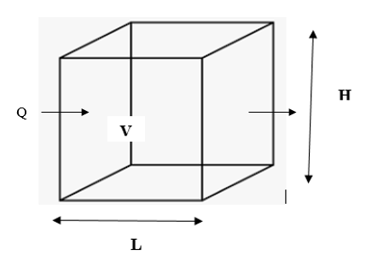
Hydraulic Retention Time
Mathematically,

Slide 21
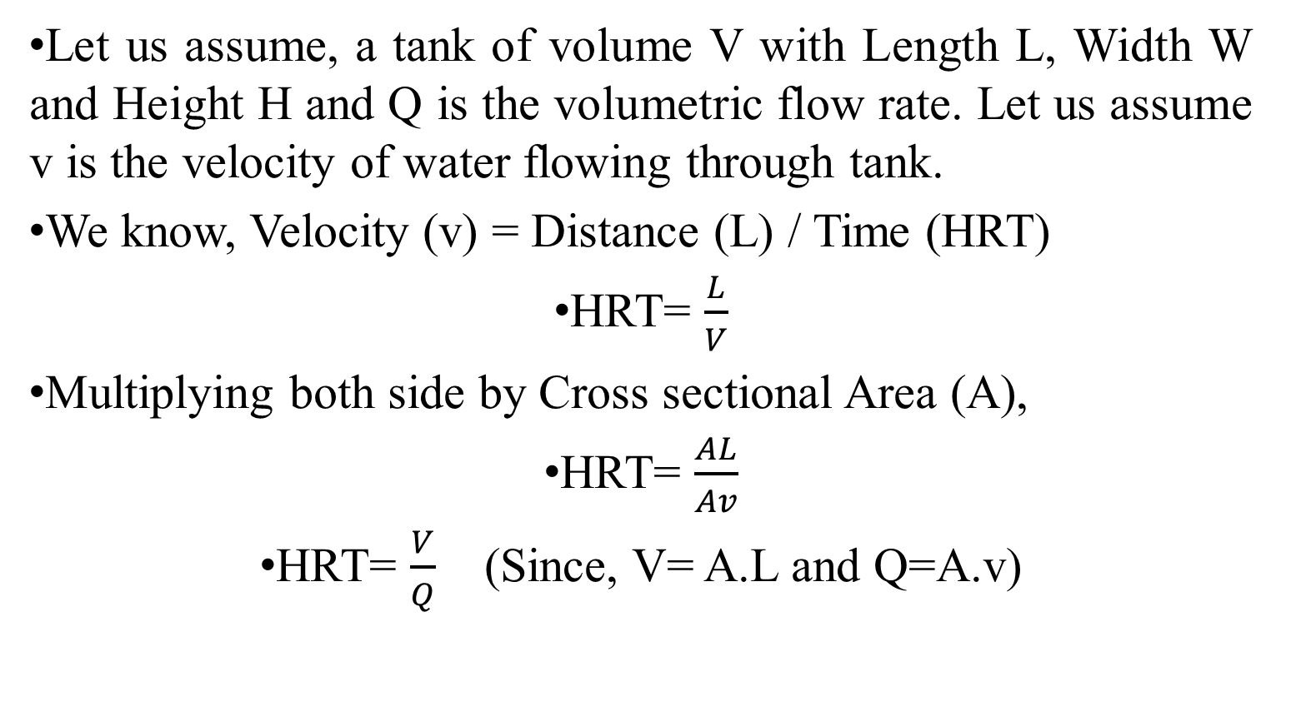
Hydraulic Retention Time
Let us assume, a tank of volume V with Length L, Width W and Height H and Q is the volumetric flow rate. Let us assume v is the velocity of water flowing through tank.
We know, Velocity (v) = Distance (L) / Time (HRT)
HRT= $\frac{L}{V}$
Multiplying both side by Cross sectional Area (A),
HRT= $\frac{AL}{Av}$
HRT= $\frac{V}{Q}$ (Since, V= A.L and Q=A.v)

Slide 22
Approximations in engineering calculations
Engineers are often called on to provide information not in its exact form but as approximations.
In the face of such problems the engineer has to draw on whatever information might be available in order to provide tentative estimations.
For example, a KU engineering graduate may be asked by a client, such as a mayor of Dhulikhel, “what it might cost to construct a new wastewater treatment plant for the population of Dhulikhel?” The mayor is not asking for an exact figure but a tentative estimate.

Slide 23
Obviously, the engineer cannot in a few minutes conduct a thorough cost estimate.
S/he would recognize the highly variable nature of land costs, construction costs, coverage of the municipality as it extends to rural areas as well, required treatment efficiency, etc.
Yet, the mayor wants a preliminary estimate – a number – and quickly!
In the face of such problems the engineer has to draw on whatever information might be available.

Slide 24
For example, s/he might know that the population of the community to be served is approximately 30,000.
Next, s/he estimates, based on experience, that the domestic wastewater flow might be about 100 Liter per capita per day, thus requiring a plant of about 3 MLD capacity.
1 MLD for industrial effluents, storm inflow and infiltration of groundwater into the sewers, s/he may estimate that .
Such domestic wastewater treatment plant, s/he is aware, cost about 25 crore (करोड) Nepali Rupees per MLD of influent wastewater treated.

Slide 25
S/he calculates that the plant would cost about 100 crore Nepali Rupees.
Giving him/ herself a cushion, h/she could respond by saying, “about 1 billion or (1 Arba) Nepali Rupees”.
This is exactly the type of information the mayor seeks.
Mayor has no use for anything more accurate because s/he might be trying to decide whether to ask for a budget of 1 billion or 1.5 billion.
There is time enough for more exact calculations later.

Slide 26
Exercise 5
The wastewater treatment plant in Guheshwori receives 0.20 m³/s of wastewater. The plant was established to directly serve a population of 2 X 10⁵ in Gokarna and Chabahil area. The total project cost of the plant was half billion Nepali Rupees (NRs) in 1999. Estimate the per capita cost of the project in 1999 in (a) NRs / MLD of treated wastewater and (b) NRs/individual benefitted.

Slide 27
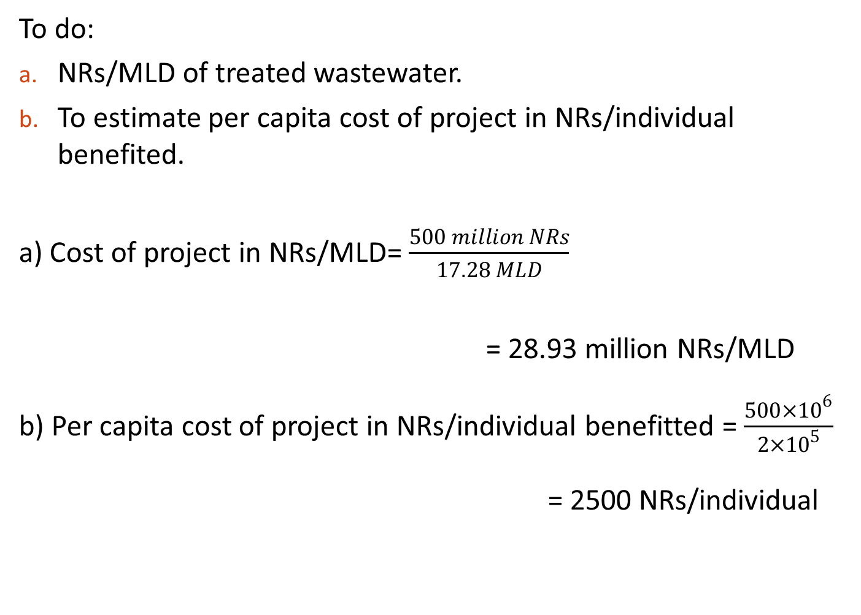
To do:
NRs/MLD of treated wastewater.
To estimate per capita cost of project in NRs/individual benefited.
a) Cost of project in NRs/MLD = $\frac{500 million NRs}{17.28 MLD}$
= 28.93 million NRs/MLD
b) Per capita cost of project in NRs/individual benefitted = $\frac{{500×10}^{6}}{{2×10}^{5}}$
= 2500 NRs/individual

Slide 28
THANKYOU

